Slide 1
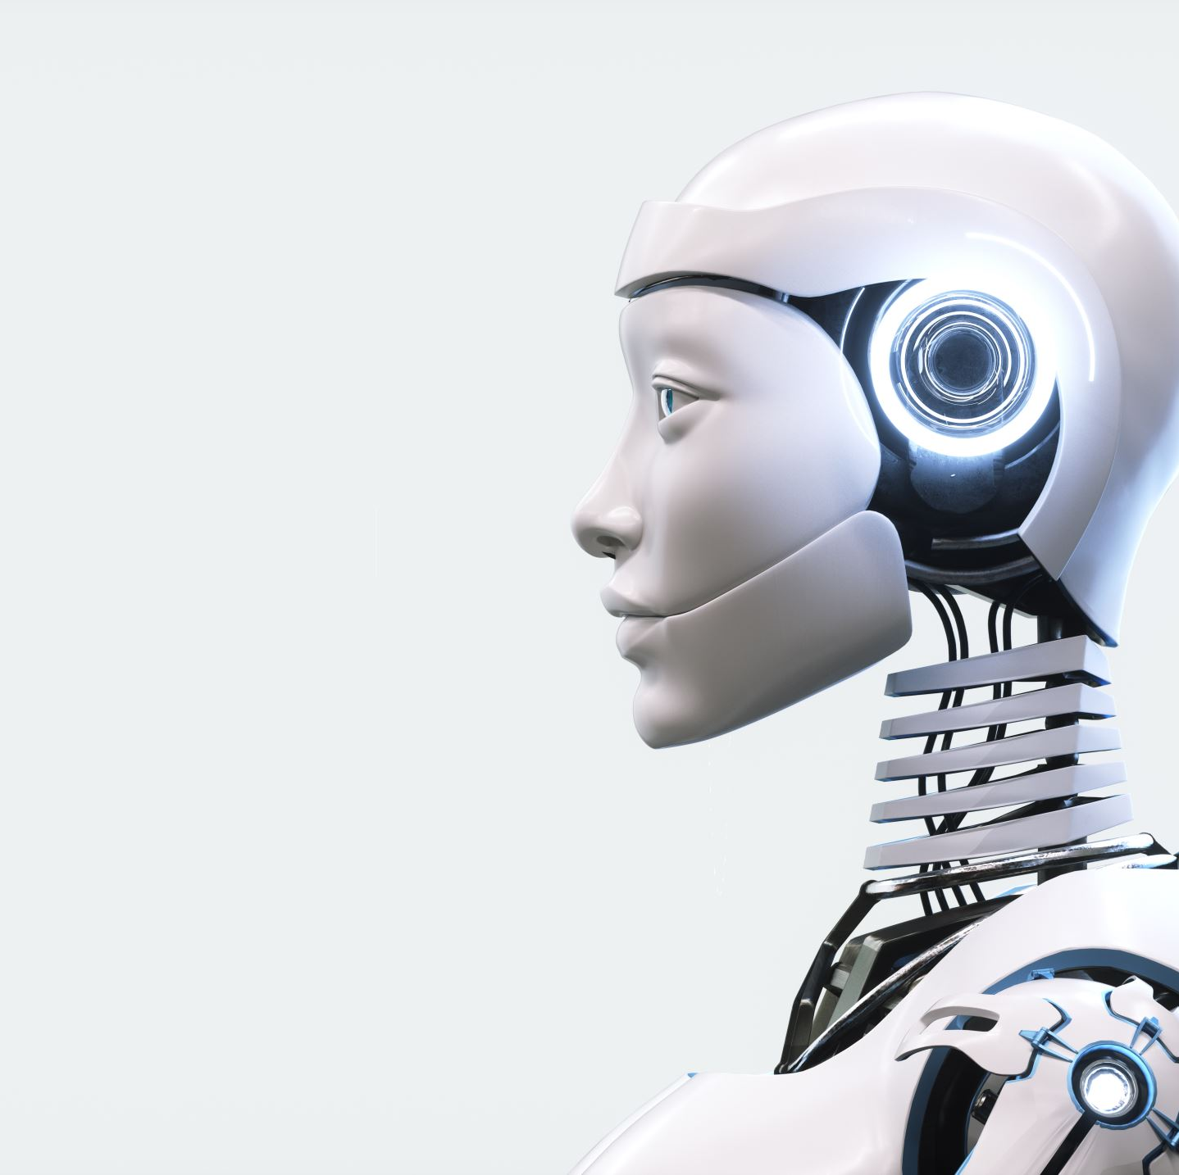

Chat-Bot For Mental Health

Slide 2
Chat-Bot For Mental Health
FYP PROPOSAL DEFENSE
Team Members
Anss Abrar (20021519-053)
Hizar Sajjad (20021519-068)
Ammara khalid (20021519-057)
Supervisor
Dr Naveed Anwar Butt

Slide 3

Problem
Rising Suicide Rates
"Limited Accessibility to Mental Health Support"
"Barriers to Quick and Confidential Help"
"Stigma and Affordability Hindering Support"
"Scarcity of Mental Health Experts"
"Addressing Gaps in Mental Health Assistance"
"Need for Confidential, Accessible Support System

Slide 4
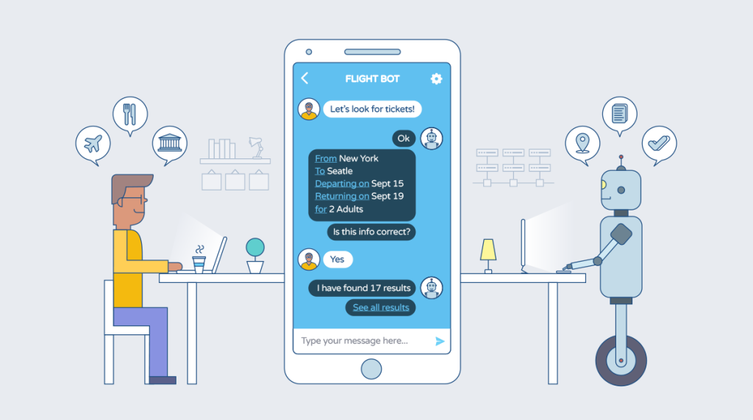
Solution
Cutting-Edge Mental Health Assistant
Immediate, Empathetic Mental Health Support
Safe and Confidential Mental Health Space

Slide 5

Objectives
Develop a Virtual Psychiatrist Chatbot
Provide Mental Therapy and Support
Maintain User Privacy and Confidentiality

Slide 6


Modules
Module 2: Mental Health Chatbot
Module 1: App UI and User Registration
Module 3: Model Deployment in App
Module 4: Chat History Database

Slide 7





Architecture
Privacy and Security Measures
User Login/Registration
Authentication
Chat Screen
Therapy and Support
Chat History Database

Slide 8

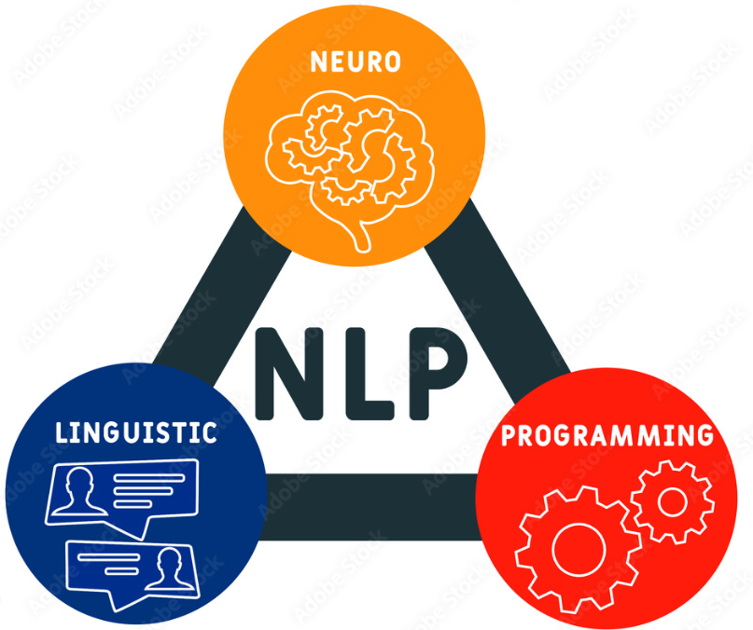




Tools & Technologies
VS code

Slide 9
Thanks for Listening

